Slide 1
roianal Tool for ROI Analysis, visualisation and line profiles
FOR INVESTIGATIONAL USE ONLY

Slide 2
Getting Started
Browse DICOM first using alternative software e.g. OsiriX, K-PACs.
Parse DICOM files
dinfo = datparse ;
For MultiFrame DICOM, select the file,
For SingleFrame DICOM, select any one of the DICOM files and then confirm the folder.
Create MATLAB variables
[volp, matp] = d2mat(dinfo,{'slice'},'op','dv') ;
Call roianal
roianal(volp,matp,'Name','pat19')
Check correct type of ROI (e.g. imline)
Enter a ROI label name if required.
Press New ROI.
If ROI is adjusted after drawing, press ‘update ROI information’
Points can be added to ROI by pressing A in figure
Right click on ROI to select color if required.
Select ROIs and press ‘Line Profiles’ if required.
Selecting Report will generate a PDF with the current figure, the ROI data, a montage of slices that have ROIs on, any line profile graphs,and, any snapshot images. Zoom and contrast the active figure before pressing Report. Report can be run multiple times if required.

Slide 3
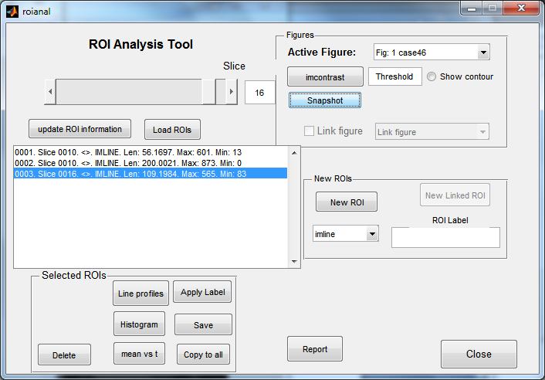
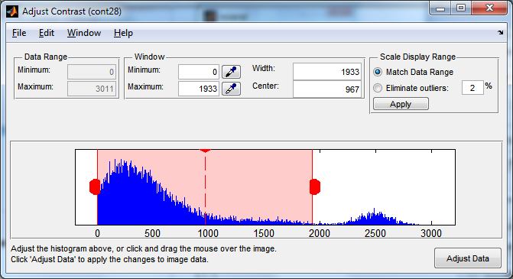
Optional
imcontrast
adjust windowing
DO NOT press ‘Adjust Data’, use the red cross to close

Slide 4
Save
Save as a .mat file to enable ROIs to be read back
Save as a .txt file for reading into Excel etc

Slide 5
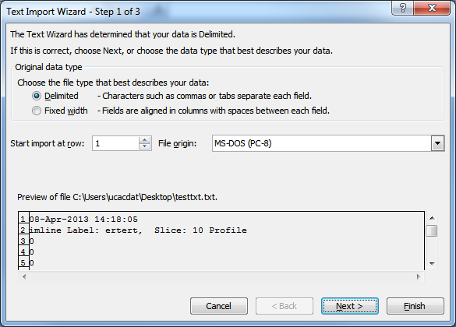
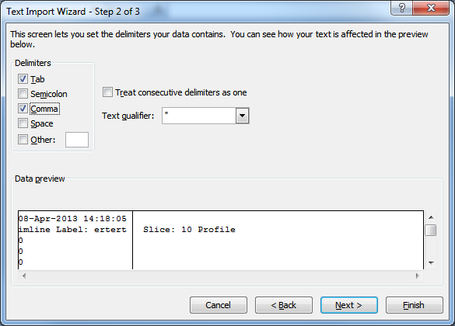
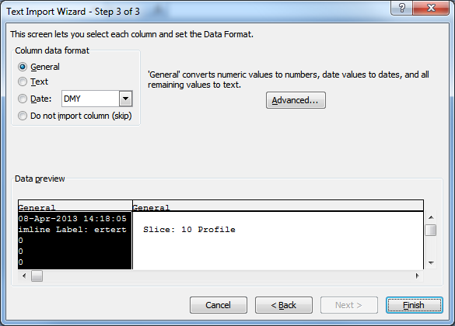
Reading .txt into Excel

Slide 6
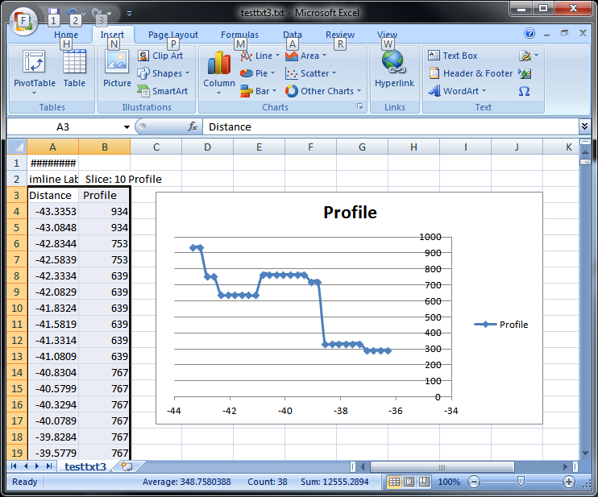
Scatter

Slide 7
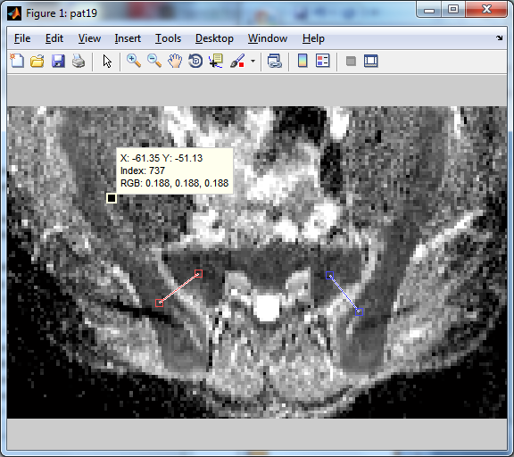
roianal figures
Zoom and pan
(turn off when finished)
Pixel information

Slide 8
Creates a snapshot of the active figure (will be included in a Report)
These operate only on the ROIs selected in the box above. When saving, make sure all you wish to save are selected.

Slide 9
Linked ROIs
ROI drawn on image can be copied (and adjusted) on another.
Datasets must have the same numbers of slices. Usually use dreslice first to get both into the same geometries.
DICOM info used to set axes scales, but no check on FrameOfReferenceUID.

Slide 10
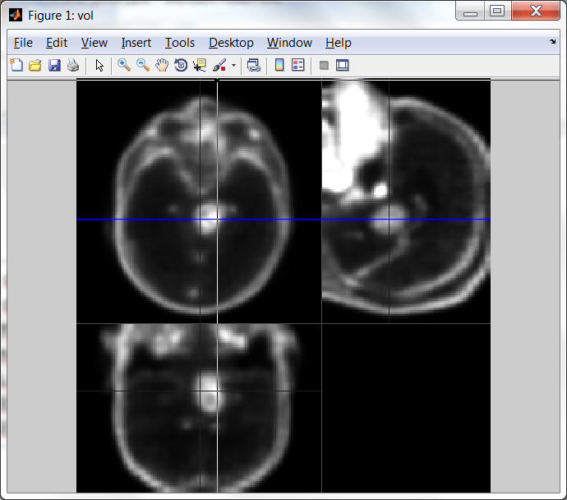
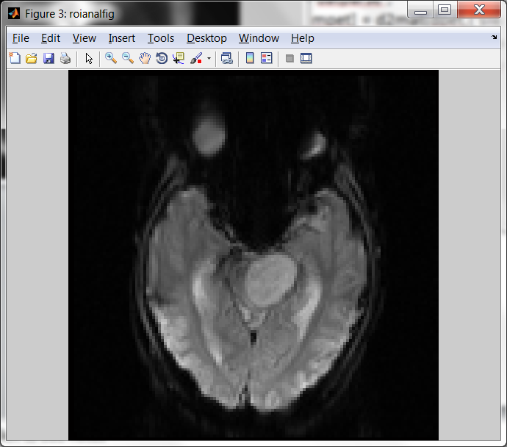
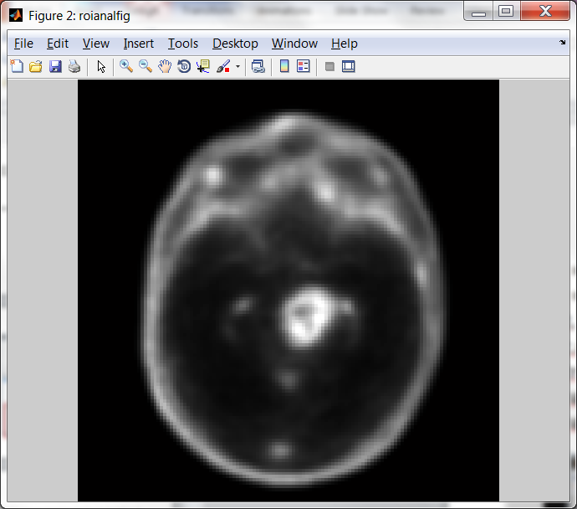
Example Work Flow
dpet = datparse ;
ddsc = datparse ;
[vpet, mpet] = d2mat(dpet,{'slice'},'op','fp') ;
[vdsc,mdsc] = d2mat(ddsc,{'slice','aqno'},'aqno',1,'op','fp') ;
[vpetrs,mpetrs] = dreslice(vpet,mpet,mdsc) ;
roianal(vpetrs,mpetrs)
roianal(vdsc,mdsc)
roianal(vpetrs,mpetrs)
From dreslice
roianal(vdsc,mdsc)

Slide 11
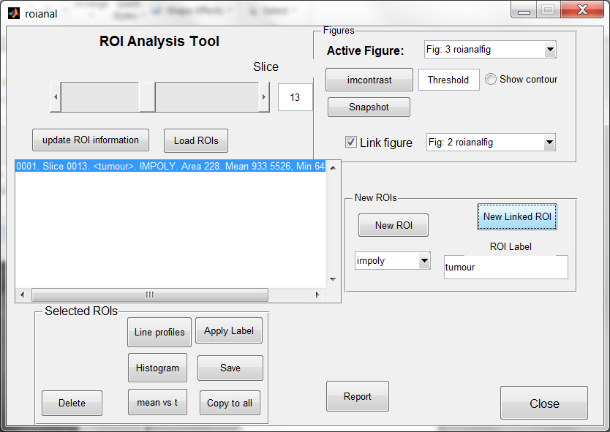
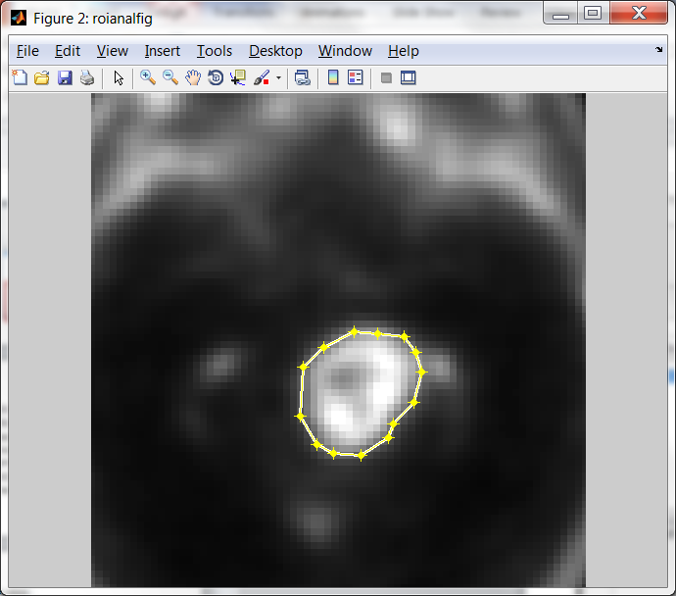
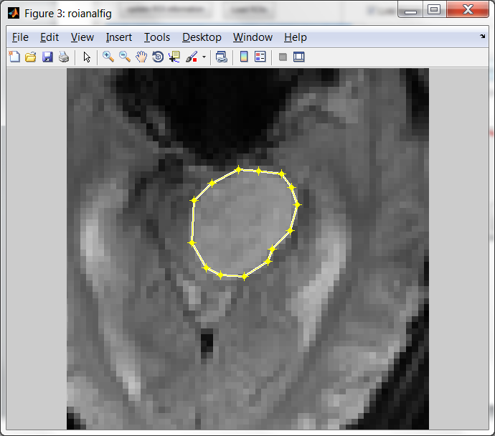
Active figure for drawing
Linked figure
Polygon ROI
Press to draw linked ROI
(here on Fig 3, linked to Fig 2)
ROI appears on linked figure, can be adjusted on either fig

